Slide 1
Basics of Wireless Sensor Network

Slide 2
Introduction
A sensor network is an infrastructure :
-- comprised of sensing (measuring), computing, and communication elements
that gives an administrator
-- the ability to instrument, observe and react to events & phenomena in a specified environment.
The administrator typically is a civil, governmental, commercial, or industrial entity.
The environment can be the physical world, a biological system or an information technology (IT) framework.

Slide 3
Introduction
There are Four Basic Components in a sensor network:
An assembly of distributed or localized sensors;
An interconnecting network (usually, but not always, wireless-based);
A central point of information clustering; and
A set of computing resources at the central point (or beyond) to handle
- data correlation,
- event trending,
- status querying, and
- data mining.

Slide 4
Introduction
Data Management -> Important Role - large quantity of data collected
Computation and communication infrastructure → specific to WSN

Slide 5
Background of Sensor Network Technology
Researchers see WSNs as an
--‘‘exciting emerging domain of deeply networked systems of low-power wireless motes
-- with a tiny amount of CPU and memory, and
-- large federated networks for
-- high-resolution sensing of the environment’’
Sensors in a WSN have a variety of purposes, functions, and capabilities.
The field is now advancing under the push of recent technological advances and the pull of a myriad of potential applications.

Slide 6
Background of Sensor Network Technology
The radar networks used in air traffic control,
the national electrical power grid, and
nationwide weather stations deployed over a regular topographic mesh are all examples of early-deployment sensor networks.
All of these systems, however, use specialized computers and communication protocols and consequently, are very expensive.
Much less expensive WSNs are now being planned for novel applications in physical security, healthcare, and commerce.

Slide 7
Background of Sensor Network Technology
Sensor networking is a multidisciplinary area that involves:
Radio and Networking,
Signal Processing,
Artificial Intelligence,
Database management,
Systems architectures for operator-friendly infrastructure administration,
Resource optimization,
Power management algorithms, and
Platform Technology (hardware and software, such as operating systems)
The applications, networking principles, and protocols for these systems are just beginning to be developed.

Slide 8
Background of Sensor Network Technology
The technology for sensing and control includes
Radio-wave frequency sensors;
Electric and Magnetic field sensors;
Optical-, Electro optic-, and Infrared sensors;
Radars;
Lasers;
Location / Navigation sensors;
Seismic and Pressure-wave sensors;
Environmental parameter sensors (wind, humidity, heat);
Biochemical national security–oriented sensors.

Slide 9
Background of Sensor Network Technology
Sensor devices, or wireless nodes (WNs), are also (sometimes) called ‘motes’.
Sensors are typically deployed in a high-density manner and in large quantities:
A WSN consists of densely distributed nodes that support sensing, signal processing, embedded computing, and connectivity;
Sensors are logically linked by self organizing

Slide 10
Background of Sensor Network Technology
WNs typically transmit information to collecting (monitoring) stations that aggregate some or all of the information.
WSNs have unique characteristics, such as, but not limited to, power constraints and limited battery life for the WNs, redundant data acquisition, low duty cycle, and, many-to-one flows.

Slide 11
Background of Sensor Network Technology
A current research and development (R&D) challenge is to develop low-power communication with low-cost on-node processing and self organizing connectivity or protocols.
Another critical challenge is the need for extended temporal operation of the sensing node despite a (typically) limited power supply (and/or battery life).
Low power consumption is a key factor in ensuring long operating horizons for non-power-fed systems (some systems can indeed be power-fed and/or rely on other power sources).

Slide 12
Background of Sensor Network Technology
Power efficiency in WSNs is generally accomplished in three ways: *
Low-duty-cycle operation.
Local/in-network processing to reduce data volume (and hence transmission time).
Multihop networking reduces the requirement for long-range transmission since signal path loss is an inverse exponent with range or distance.
Each node in the sensor network can act as a repeater, thereby reducing the link range coverage required and, in turn, the transmission power.

Slide 13
Classification of Sensor Network
Sensor Networks and Systems taxonomies into two categories:
Category 1 WSNs (C1WSNs): almost invariably mesh-based systems with multi-hop radio connectivity among or between WNs, utilizing dynamic routing in both the wireless and wire-line portions of the network.
→Military-theater systems typically belong to this category.
Category 2 WSNs (C2WSNs): Point-to-point or multipoint-to-point (star-based) systems generally with single-hop radio connectivity to WNs, utilizing static routing over the wireless network; typically, there will be only one route from the WNs to the companion terrestrial or wire-line forwarding node (WNs are pendent nodes).
→ Residential control systems typically belong to this category.

Slide 14
Background of Sensor Network Technology
C1WSNs | C2WSNs
support highly distributed high-node-count applications | support confined short-range spaces
e.g., environmental monitoring, national security systems | e.g. home, a factory, a building, or the human body.
different in scope and/or reach from evolving wireless | for short-range low-data-rate wireless applications
 | RFID (radio-frequency identification) systems, light switches, fire and smoke detectors, thermostats, and, home appliances
tend to deal with large-scale multipoint-to-point systems with massive data flows | tend to focus on short-range point-to point, source-to-sink applications with uniquely defined transaction-based data flows.
Notes:
dfdsgfgf

Slide 15
MANETs
There is considerable research in the area of mobile ad hoc networks (MANETs).
MANETs are similar to WSNs in some ways; for example, both involve multi-hop communications. But the applications and technical requirements for the two systems are significantly different in several respects.
The typical mode of communication in WSN is from multiple data sources to a data recipient or sink rather than communication between a pair of nodes.
In other words,
Sensor Nodes use multicast or broadcast communication,
MANETs are based on point-to-point communications.

Slide 16
MANETs
In most scenarios the sensors themselves are not mobile; this implies that the dynamics in the two types of networks are different.
Because the data being collected by multiple sensors are based on common phenomena, there is potentially a degree of redundancy in the data being communicated by the various sources in WSNs; this is not generally the case in MANETs.
The number of sensor nodes in a sensor network can be several orders of magnitude higher than the nodes in a MANET.

Slide 17
MANETs
Because the data being collected by multiple sensors are based on common phenomena, there is potentially some dependency on traffic event generation in WSNs, such that some typical random-access protocol models may be inadequate at the queuing-analysis level; this is generally not the case in MANETs.
A critical resource constraint in WSNs is energy; this is not always the case in MANETs, where the communicating devices handled by human users can be replaced or recharged relatively often.
The scale of WSNs (especially, C1WSNs) and the necessity for unattended operation for periods reaching weeks or months implies that energy resources have to be managed very judiciously. This, in turn, precludes high-data-rate transmission.

Slide 18
Comparison between WSN and WAN *
The number of nodes in sensor network can be several orders of magnitude larger than the wireless ad hoc network
Sensor nodes are more prone to failure and energy drain and their battery resources are usually not replicable or rechargeable.
Sensor nodes may not have global identifiers, so unique addressing is not feasible in sensor network.
Sensor nodes are data centric, while ad hoc wireless network is address centric.
Sensor network require different mechanism for routing & answering queries.

Slide 19
Applications of Sensor Networks
Traditionally, sensor networks have been used in the context of high-end applications such as:
Military applications
Monitoring inimical forces
Monitoring friendly forces and equipment
Military-theatre or battlefield surveillance
Targeting
Battle damage assessment
Nuclear, biological, and chemical attack detection

Slide 20
Applications of Sensor Networks
Environmental applications
Microclimates
Forest fire detection
Flood detection
Precision agriculture
Health applications
Remote monitoring of physiological data
Tracking and monitoring doctors and patients inside a hospital
Drug administration
Elderly assistance

Slide 21
Applications of Sensor Networks
Home applications
Home automation
Instrumented environment
Automated meter reading
Commercial applications
Environmental control in industrial and office buildings
Inventory control
Vehicle tracking and detection
Traffic flow surveillance

Slide 22
Basic Sensor N/W Architectural Elements
A sensor network is composed of a large number of sensor nodes that are densely deployed.
sensor nodes may be deployed in an open space; on a battlefield in front of, or beyond, enemy lines; in the interior of industrial machinery; at the bottom of a body of water; in a biologically and/or chemically contaminated field; in a commercial building; in a home; or in or on a human body.
A sensor node typically has embedded processing capabilities and onboard storage; the node can have one or more sensors operating in the acoustic, seismic, radio (radar), infrared, optical, magnetic, and chemical or biological domains. (Sensor Types and Technology)

Slide 23
Basic Sensor N/W Architectural Elements
The node has communication interfaces, typically wireless links, to neighbouring domains.
The sensor node also often has location and positioning knowledge that is acquired through a global positioning system (GPS) or local positioning algorithm.
Sensor nodes are scattered in a special domain called a sensor field.
Each of the distributed sensor nodes typically has the capability to collect data, analyze them, and route them to a (designated) sink point.

Slide 24
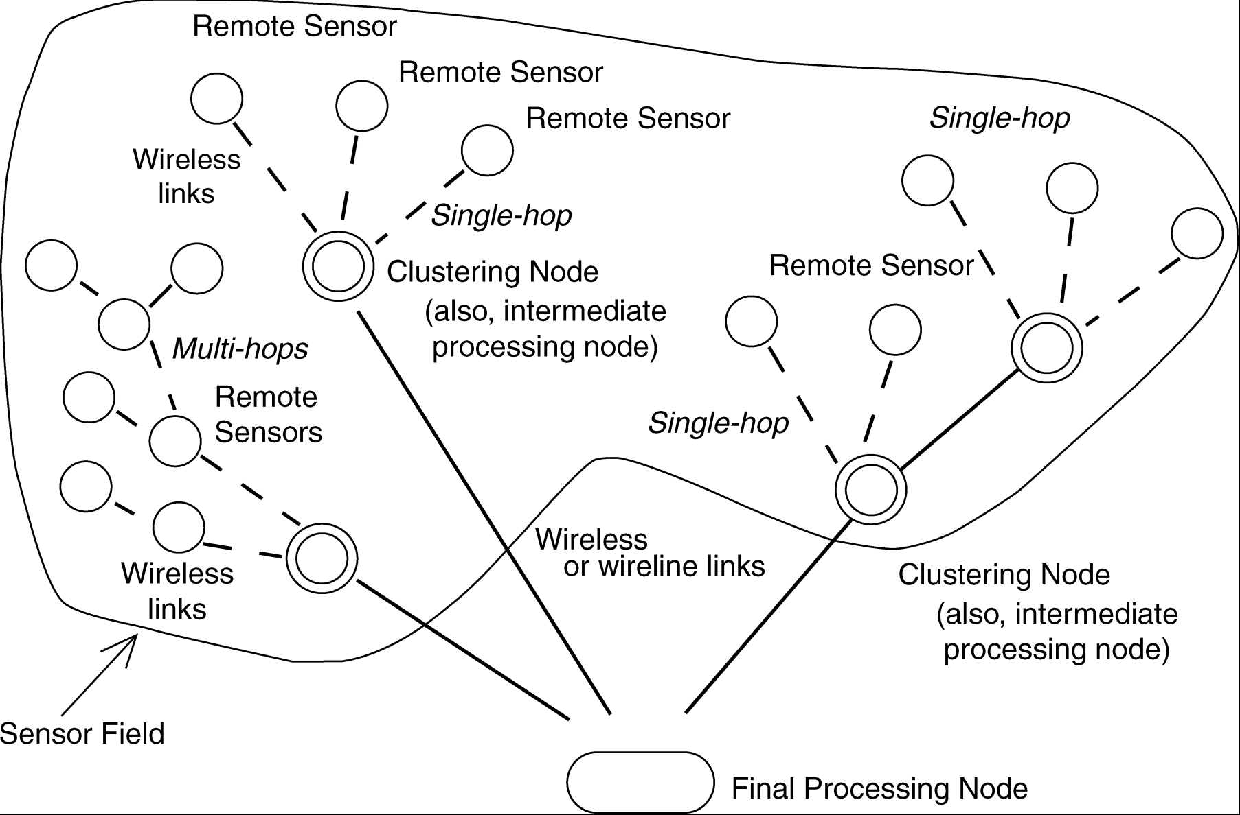
Typical sensor network arrangement

Slide 25
Basic Sensor N/W Architectural Elements
Important issues pertaining to WSNs:
sensor type;
sensor placement;
sensor power consumption,
operating environment,
signal processing capabilities
connectivity,
telemetry or control of remote devices.
Node location and fine-grained time (stamping) are essential for proper operation of a sensor network.

Slide 26
Basic Sensor N/W Architectural Elements
Embedded sensor networks are predicated on three supporting components: Embedding, Networking, and Sensing.
Embedding implies the incorporation of numerous distributed devices to monitor the physical world and interact with it.
The devices are untethered nodes of small form factors that are equipped with a control and communication subsystem.
Spatially- and Temporally-dense arrangements are common.

Slide 27
Basic Sensor N/W Architectural Elements
Networking implies the concept of physical and logical connectivity.
Logical connectivity has the goal of supporting coordination and other high-level tasks.
Physical connectivity is typically supported over a wireless radio link.

Slide 28
Basic Sensor N/W Architectural Elements
Sensing implies the presence of these capabilities in a tightly coupled environment, typically for the measurement of physical-world parameters.
Some of the characteristic features of sensor networks include the following
Sensor nodes are densely deployed.
Sensor nodes are prone to failures.
The topology of a sensor network changes very frequently.
Sensor nodes are limited in power, computational capacities, and memory.
Sensor nodes may not have global identification because of the large amount of overhead and the large number of sensors.

Slide 29
Sensor networks require sensing systems that are long-lived and environmentally resilient.
Unattended, untethered, self-powered low-duty-cycle systems are typical.
In most instances, communication circuitry and antennas are the primary elements that draw most of the energy.
Sensors are either passive or active devices. Passive sensors in element form include seismic-, acoustic-, strain-, humidity-, and temperature-measuring devices.
Passive sensors tend to be low-energy devices.
Active sensors include radar and sonar; these tend to be high-energy systems.

Slide 30
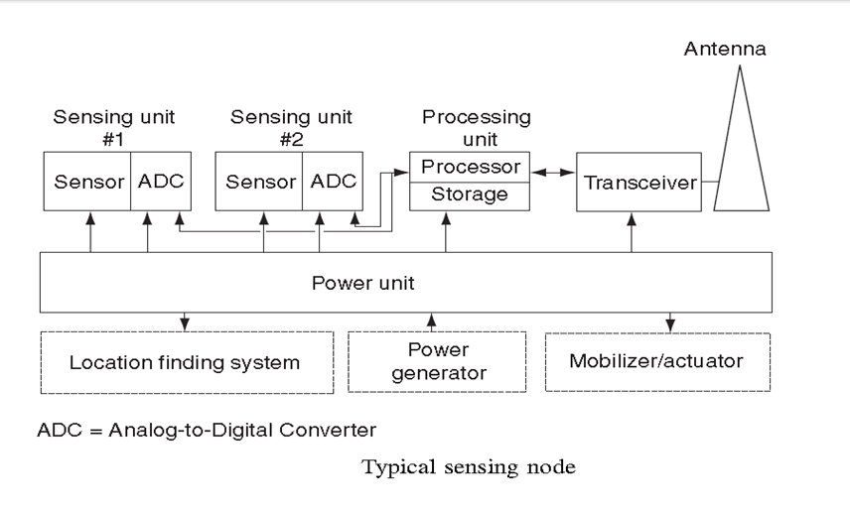

Slide 31
The components of a (remote) sensing node include the following:
A sensing and actuation unit (single element or array)
A processing unit
A communication unit
A power unit
Other application-dependent units

Slide 32
Categorization of issues related to sensor and their communication/computing architecture
Categorization of issues related to sensor and their communication/computing architecture
Sensors
Size: Small [e.g., nanoscale electromechanical systems (MEMS)], medium [e.g., microscale electromechanical systems (MEMS)], and large (e.g., radars, satellites): cubic centimetres.
Mobility: stationary (e.g., seismic sensors), mobile (e.g., on robot vehicles)
Type: passive (e.g., acoustic, seismic, video, infrared, magnetic) or active (e.g., radar)

Slide 33
Categorization of issues related to sensor and their communication/computing architecture
Communication
Networking: wired (on occasion) or wireless (more common)
Bandwidth: high (on occasion) or low (more typical)
Processing Architecture
Centralized (all data sent to central site), distributed or in-network architecture (located at sensor or other sides), or hybrid.
Operating Environment
Monitoring requirement: distributed (e.g., environmental environment monitoring) or localized (e.g., target tracking)
Number of sites: sometimes small, but usually large (especially for C1WSNs)

Slide 34
Categorization of issues related to sensor and their communication/computing architecture
Spatial coverage: dense, spars: C1WSN: low-range multi-hop or C2WSN: low-range single-hop (point-to-point)
Deployment: fixed and planned (e.g., factory networks) or ad hoc (e.g., air-dropped)
Environment: benign (factory floor) or adverse (battlefield)
Nature: cooperative (e.g., air traffic control) or non cooperative (e.g., military targets)
Composition: homogeneous (same types of sensors) or heterogeneous (different types of sensors)

Slide 35
Software (Operating Systems and Middleware)
To support the node operation, it is important to have open-source operating systems designed specifically for WSNs.
Such operating systems typically utilize a component-based architecture that enables rapid implementation and innovation while minimizing code size as required by the memory constraints endemic in sensor networks.
Tiny OS is one such example of a de facto standard, but not the only one.

Slide 36
Software (Operating Systems and Middleware)
Tiny OS’s component library includes network protocols, distributed services, sensor drivers, and data acquisition tools; these can be used as-is or be further refined for a specific application.
Tiny OS’s event-driven execution model enables fine-grained power management, yet allows the scheduling flexibility made necessary by the unpredictable nature of wireless communication and physical world interfaces.
A wide community uses Tiny OS in simulation to develop and test various algorithms and protocols, and numerous groups are actively contributing code to establish standard interoperable network services

Slide 37
Standards for Transport Protocols
The goal of WSN engineers is to develop a cost-effective standards-based wireless networking solution that supports low to medium data rates, has low power consumption, and guarantees security and reliability.
The position of sensor nodes does not have be predetermined, allowing random deployment in inaccessible terrains or dynamic situations; however, this also means that sensor network protocols and algorithms must possess self-organizing capabilities.

Slide 38
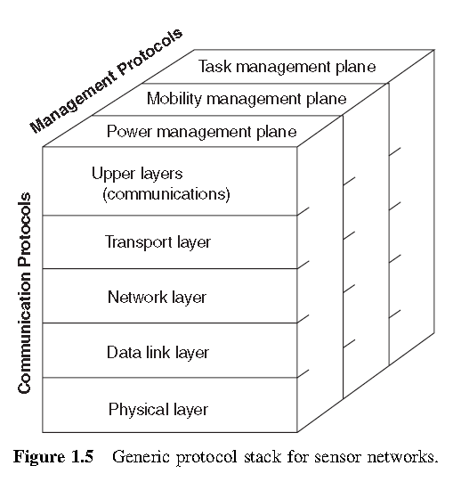
Standards for Transport Protocols
For military and / or national security applications sensor devices must be amenable to rapid deployment, the deployment must be supportable in an ad hoc fashion, and the environment is expected to be highly dynamic.
Figure 1.5 depicts a generic protocol stack model that can be utilized to describe the communications apparatus.

Slide 39
Possible WSN Protocol Stack
Upper layers | In-network applications, including application processing, data aggregation, external querying query processing, and external database
Layer 4 | Transport, including data dissemination and accumulation, caching, and Storage
Layer 3 | Networking, including adaptive topology management and topological Routing
Layer 2 | Link layer (contention): channel sharing (MAC), timing, and locality
Layer 1 | Physical medium: communication channel, sensing, actuation, and signal Processing

Slide 40
Possible Lower-Layer WSN Protocols
 | GPRS/GSM 1xRTT/CDMA | IEEE 802.11b/g | IEEE 802.15.1 | IEEE 802.15.4
Market name for standard | 2.5G/3G | Wi-Fi | Bluetooth | Zig-Bee
Network target | WAN/MAN | WLAN and hotspot | PAN and DAN (desk area n/w) | WSN
Application focus | Wide area voice and data | Enterprise applications (data and VoIP) | Cable replacement | Monitoring & control
Bandwidth (Mbps) | 0.064–0.128+ | 11–54 | 0.7 | 0.020–0.25
Transmission range (ft) | 3000+ | 300+ | 30+ | 300+
Design factors | Reach and transmission quality | Enterprise support, cost & scalability | Cost, ease of use | Reliability, power, cost

Slide 41
Issues:- relate to Networking
Physical connectivity and coverage: How can one interconnect dispersed sensors in a cost-effective and reliable manner, and what medium should be used (e.g., wireless channels)?
Link characteristics and capacity, along with data compression.
Networking security and communications reliability (including naturally occurring phenomena such as noise impairments, and malicious issues such as attacks, interference, and penetration)
Physical-, link-, network-, and transport-layer protocols, with an eye to reliable transport, congestion detection and avoidance, and scalable and robust communication.
Communication mechanisms in what could be an environment with highly correlated and time-dependent arrivals (where many of the queuing assumptions used for system modelling could break down.

Slide 42
Sensor Network Technology
The basic functionality of a WN generally depends on the application, but the following requirements are typical :
Determine the value of a parameter at a given location. For example, in an environment-oriented WSN, one might need to know the temperature, atmospheric pressure, amount of sunlight, and the relative humidity at a number of locations. This example shows that a given WN may be connected to different types of sensors, each with a different sampling rate and range of allowed values.

Slide 43
Sensor Network Technology
Detect the occurrence of events of interest and estimate the parameters of the events. For example, in a traffic-oriented WSN, one would like to detect a vehicle moving through an intersection and estimate the speed and direction of the vehicle.
Classify an object that has been detected. For example, is a vehicle in a traffic sensor network a car, a minivan, a light truck, a bus?
Track an object. For example, in a military WSN, track an enemy tank as it moves through the geographic area covered by the network.

